Slide 1
Unit 7 Jeopardy
American Culture, Civil Rights, and Foreign Affairs
By: Stephanie Sciturro-Smith
Click Screen for Next Slide

Slide 2
Vocab Terms
Text
Questions
Lectures
Various
Topics
Employee
Behavior
100
100
100
100
200
200
200
200
300
300
300
300
400
400
400
400

Slide 3
Question: Vocab Terms for 100 Points
Define the following:
  Limited War-
Answer

Slide 4
Answer: Vocab Terms for 100 Points
Limited War- a war fought to achieve a limited objective, such as containing communism.
BACK

Slide 5
Question: Vocabulary for 200 Points
Define the following:
  Potsdam-
Answer

Slide 6
Answer: Vocabulary for 200 Points
Potsdam- where Truman met Stalin; located near Berlin. It was the place where they planned to make a deal, but Stalin opposed his offers and ideas. It is also where Truman learned about the Atomic bomb and told Stalin of it, forcing Stalin to accept the deal. It marked another increase of tension between the USSR and the U.S. furthering the start of the Cold War.
BACK

Slide 7
Question: Vocabulary for 300 Points
Define the following and explain the advantage:
  Massive Retaliation-
  Truman Doctrine-
Answer

Slide 8
Answer: Vocabulary for 300 Points
Massive retaliation- to threaten to use nuclear weapons if a Communist state tried to seize territory by force. It enabled Eisenhower to cut a great amount of military money and to increase America’s nuclear arsenal.
Truman Doctrine- Truman’s speech stating the policy that’s goal was to aid free peoples who resisted attempting subjugation by armed minorities or outside pressures
BACK

Slide 9
Question: Vocabulary for 400 Points
Define the following and explain:
  Containment-
  McCarran Act-
Answer

Slide 10
Answer: Vocabulary for 400 Points
Containment- to keep communism within its present territory through the use of diplomatic, economic, and military actions.
It was Americas policy throughout the Cold War. If the U.S. could follow through with this policy and keep the Soviets from expanding their power the Soviets system would crumble.
McCarran Act- made it illegal to combine, conspire, or agree with any other person to perform any act which would substantially contribute to the establishment of a totalitarian government; communists must register with govt. & be watched
BACK

Slide 11
Question: Text Questions for 100 Points
What were three events that led to the Cold War?
Answer

Slide 12
Answer: Text Questions for 100 Points
Potsdam Conference
Yalta arguments about reparations and economic policy
Violation of the Declaration of Liberated Europe by Soviets
Atomic bomb
China becoming Communist
Berlin conflict
Domination of Eastern Europe
Domino Theory
Containment Policy
BACK

Slide 13
Question: Text Questions for 200 Points
What were three conflicts between the USSR and the U.S.?
How did the Long Telegram influence American Policy?
Answer

Slide 14
Answer: Text Questions for 200 Points
Crisis in Iran
Berlin Airlift
War in China and Korea
The Long Telegram influenced American policy by creating the policy of containment, which kept communism with in it’s present territory through the use of diplomatic, economic, and military actions. It circulated widely around Truman's administration / long and patient opposition to communism
BACK

Slide 15
Question: Text Questions for 300 Points
What was the long term Cold War strategy that the U.S. followed and why was it followed?
Answer

Slide 16
Answer: Text Questions for 300
The U.S. strategy was a patient but firm and vigilant containment of Russian expansive tendencies. This was followed because the Soviet system was believed to have several major economic and political weaknesses. If they could stop the expanding then the Soviets system would fall and the matter of Communism would not have to be settled by war.
BACK

Slide 17
Question: Text Questions for 400
What did both the Truman Doctrine and the Marshall plan address?
Answer

Slide 18
Answer: Text Questions for 400
Both addressed the spread of Communism by pledging the U.S to fight communism worldwide. Also to aid the Greek government in which the Greek communists launched guerrilla war upon because the Soviets wanted to expand and control the mid east. The Marshall plan followed the doctrine to aid all of Europe to rebuild there economies and to escape communism and its spreading.
BACK

Slide 19
Question: Lectures for 100
Who were Julius and Ethel Rosenberg?
Answer

Slide 20
Answer: Lectures for 100
Julius and Ethel Rosenberg- first civilians executed for espionage in U.S. history
  -Charged with giving a complete set of designs to a shooting star rocket and information from the Manhattan Project to the communists
  -Proof that they did it was mishandled by the persecution and today they would be set free
  -We knew he was a communist and she was charged for typing secrets
  -No actual information was found “ he said , she said situation”
  -They were Jewish
BACK

Slide 21
Question: Lectures for 200
What did women do during the times of Suburban living?
Answer

Slide 22
Answer: Lectures for 200
  -Multitask
  -They were miserable
  -Betty Friedan wrote a famous book called,” The Feminist Mystique”, which describes why women are so miserable
  -Women start drinking and smoking because of this
  Drink cocktails so it wasn’t obvious ( cocktail party)
    -Invite friends to impress them with your home
    -Feed them finger sandwiches
    -6:30- 9:00 pm it lasted
-Had Barbeques
  -Invite neighbors
  -Still drink
  -Leisure time
-Break down of the extended family and the beginning of the emphasis of the Nuclear Family
BACK

Slide 23
Question: Lectures for 300
Explain the Berlin Airlift
Answer

Slide 24
Answer: Lectures for 300
Berlin Airlift- 1948-1949
  -US aid to a city being threatened by Communism
  -Berlin is the capitol city of Germany
  -Germany has lost the war and is occupied by four nations [ US, UK, France, Russia]
  -3 countries own the West and Russia owns the East
  -Berlin is located in the east and is controlled by all 4 nations
  -The Russians block the road between West Berlin and West Germany
    Options:
      -Atomic Bomb
      -Build a new road
      -Start World War three
  -Decide to fly into Berlin to take care of their needs
  -For eighteen months we fly in material things free of charge for over a million people
    -We want to tick off the Russians off and get the people we are helping on our side
    -Gale Halvorson “ Chocolate Airman “
      -Threw chocolate bars to kids in the cemetery in Berlin, for a year
BACK

Slide 25
Question: Lectures for 400
Define and explain each section of the United Nations
Answer

Slide 26
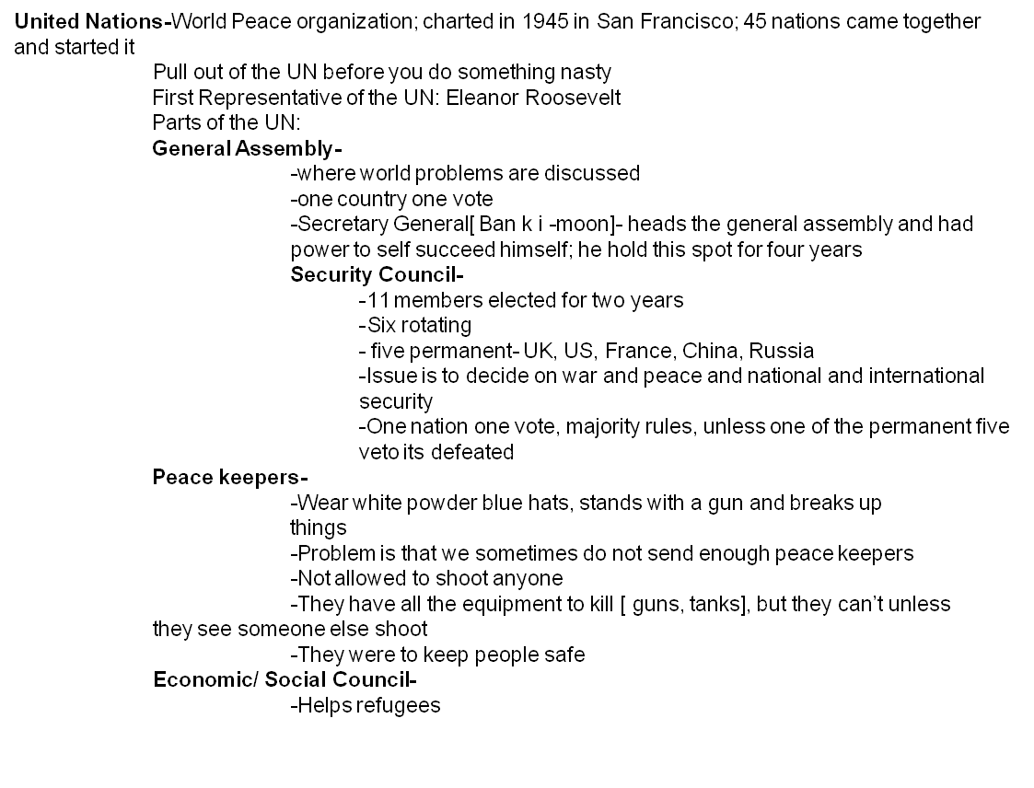
Answer: Lectures for 400
BACK

Slide 27
Question: Various Topics for 100
How long did the Montgomery Bus Boycott Last and Who was the new minister to it?
Answer

Slide 28
Answer: Various Topics for 100
The Montgomery Bus Boycott is where all the African Americans
Protested to integrate the bus system. The new minister who lead
the boycott was Martin Luther King Jr.
BACK

Slide 29
Question: Various Topics for 200
Who fought the Korean War? And What were three reasons it was fought?
Answer

Slide 30
Answer: Various Topics for 200
  Who fought?
    -United Nations supporting the Republic of Korea against the Democratic People’s Republic of Korea and its allies the Soviet Union and the People’s Republic of China
    -The U.S. and Soviet Union divided Korea at the 38th parallel
    -The Soviet Union occupied the north and the U.S. occupied the South
  Three reasons why they fought:
      1. To disarm the Japanese troops stationed there
      2. The North Korean troops invaded the south making Truman able to test the containment policy
      3. To reunify Korea
BACK

Slide 31
Question: Various Topics for 300
What were three important results of the Korean Conflict?
Who were the Little Rock Nine and why did they have troops escort them to class?
Answer

Slide 32
Answer: Various Topics for 300
Three important results:
  1. It helped to expand the Cold War to Asia
  2. Defense agreements were signed with Japan, South Korea, Taiwan, the Philippines, and Australia
  America aided in fighting Communist guerrillas in Vietnam
The Little Rock Nine, were nine African American kids who went to Central High school at the time they were desegregating it. Troops would have to escort them to every class and wait for them outside the classroom because the white students would throw things at them, beat them, and potentially kill them.
BACK

Slide 33
Question: Various Topics for 400
Who is Alger Hiss,what was he accused of and what happened to him because of this?
Answer

Slide 34
Answer: Various Topics 400
-He was accused of being a communist and attorney working for the U.S government; he was brought to court for lying under oath
  -He was a part of:
    -Yalta Conference
    -Creation of United Nations
    -Nye committee- said we went to WW1 so that we could make money and banks could make loans not under democracy
    -AAA- adjusted prices to sell and buy on demand
-Someone said he was a member of the communist party and accused of espionage
-He was never proven to do anything except to lie under oath (Perjury)
-Sentenced to jail ( 2 years of a 5 year sentence)
BACK

Slide 35

Appleby, J., Brinkley, A., Broussard, A., McPherson, J., & Ritchie, D. (2005). The American Vision. New York, NY. The McGraw- Hill
“Battle of Chosin Reservoir”. Wikipedia. Retrieved 26 January 2010. Last updated 25 January 2010. <http://en.wikipedia.org/wiki/Battle_of_Chosin_Reservoir>.
Dr. Crihfield.”Public Lectures”. Retrieved the weeks of January 2010 and February 2010.
“Korean War”. Wikipedia. Retrieved 25 January 2010. Last updated January 2010. <http://en.wikipedia.org/wiki/Korean_War>.

